Slide 1

[SW372] Applied Data Analysis
Chapter 03. Regression
Dept. of SW Convergence
Sangkeun Park
Image by our-team on Freepik

Slide 2
Slide Update History
Date | Description
2024.03.18 | The first version

Slide 3
Objective
Understanding the characteristics of different regression analyses and when to use them
Choosing Regression Algorithms Appropriately
Understanding Evaluation Methods for Regression

Slide 4
Regression
A mathematical or computational technique used to model the relationship between an independent variable(s) and a dependent variable
The main goal of regression algorithms is
to predict the continuous value of the dependent variable based on the values of the independent variable(s)
to find optimized a regression coefficient number(s) of an independent variable(s) for predicting a dependent variable

Slide 5
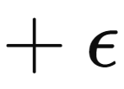
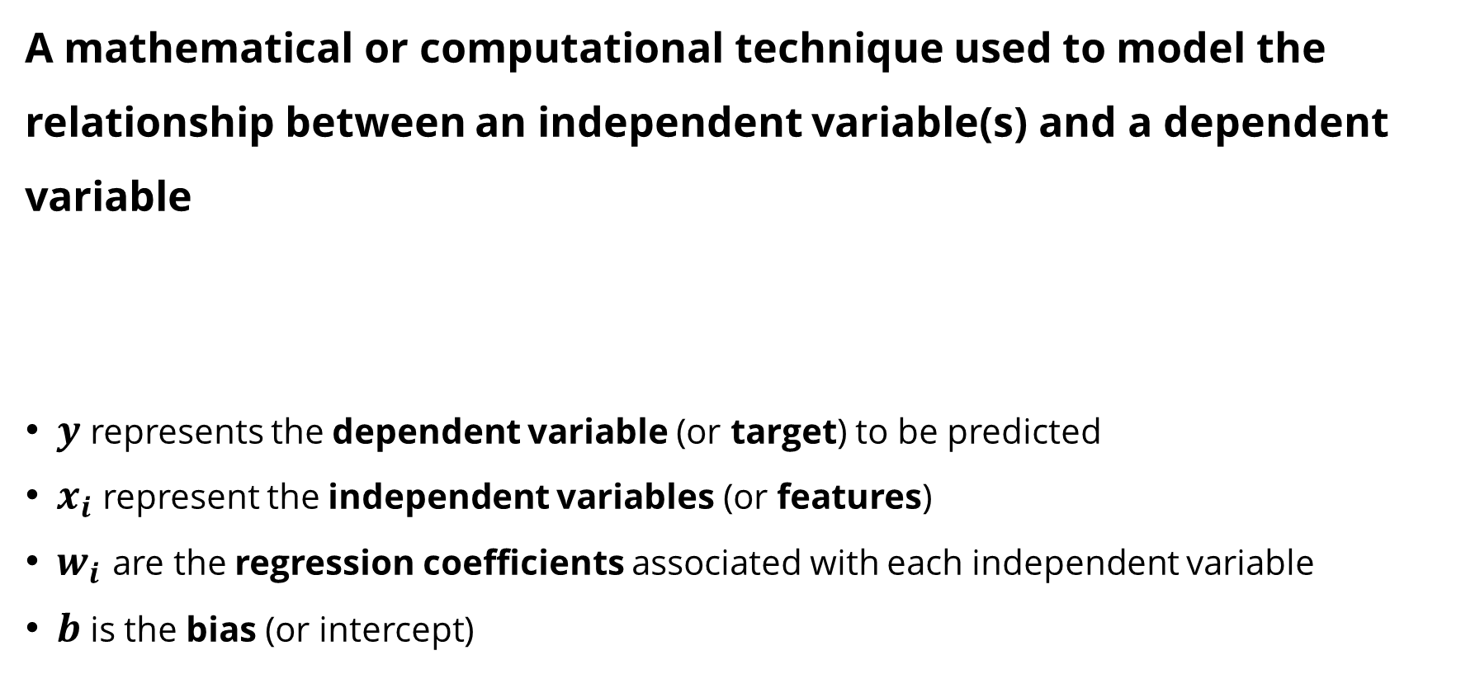
Regression
A mathematical or computational technique used to model the relationship between an independent variable(s) and a dependent variable
$y$ represents the dependent variable (or target) to be predicted
$x_{i}$ represent the independent variables (or features)
$w_{i}$ are the regression coefficients associated with each independent variable
$b$ is the bias (or intercept)

Slide 6
Regression
(Linear) Regression Algorithms
Linear regression
Polynomial regression
Ridge regression
Lasso regression
ElasticNet regression

Slide 7
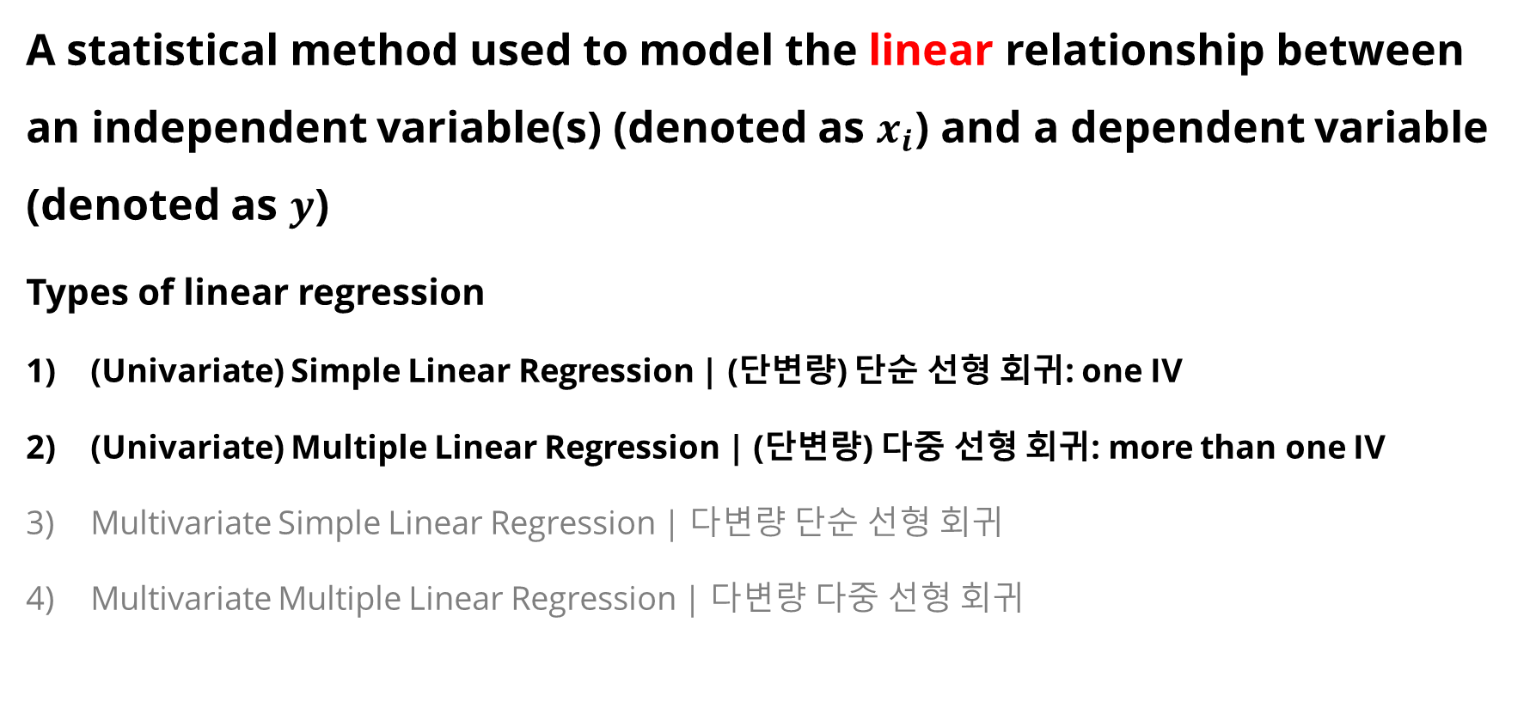
1. Linear Regression
A statistical method used to model the linear relationship between an independent variable(s) (denoted as $x_{i}$) and a dependent variable (denoted as $y$)
Types of linear regression
(Univariate) Simple Linear Regression | (단변량) 단순 선형 회귀: one IV
(Univariate) Multiple Linear Regression | (단변량) 다중 선형 회귀: more than one IV
Multivariate Simple Linear Regression | 다변량 단순 선형 회귀
Multivariate Multiple Linear Regression | 다변량 다중 선형 회귀

Slide 8
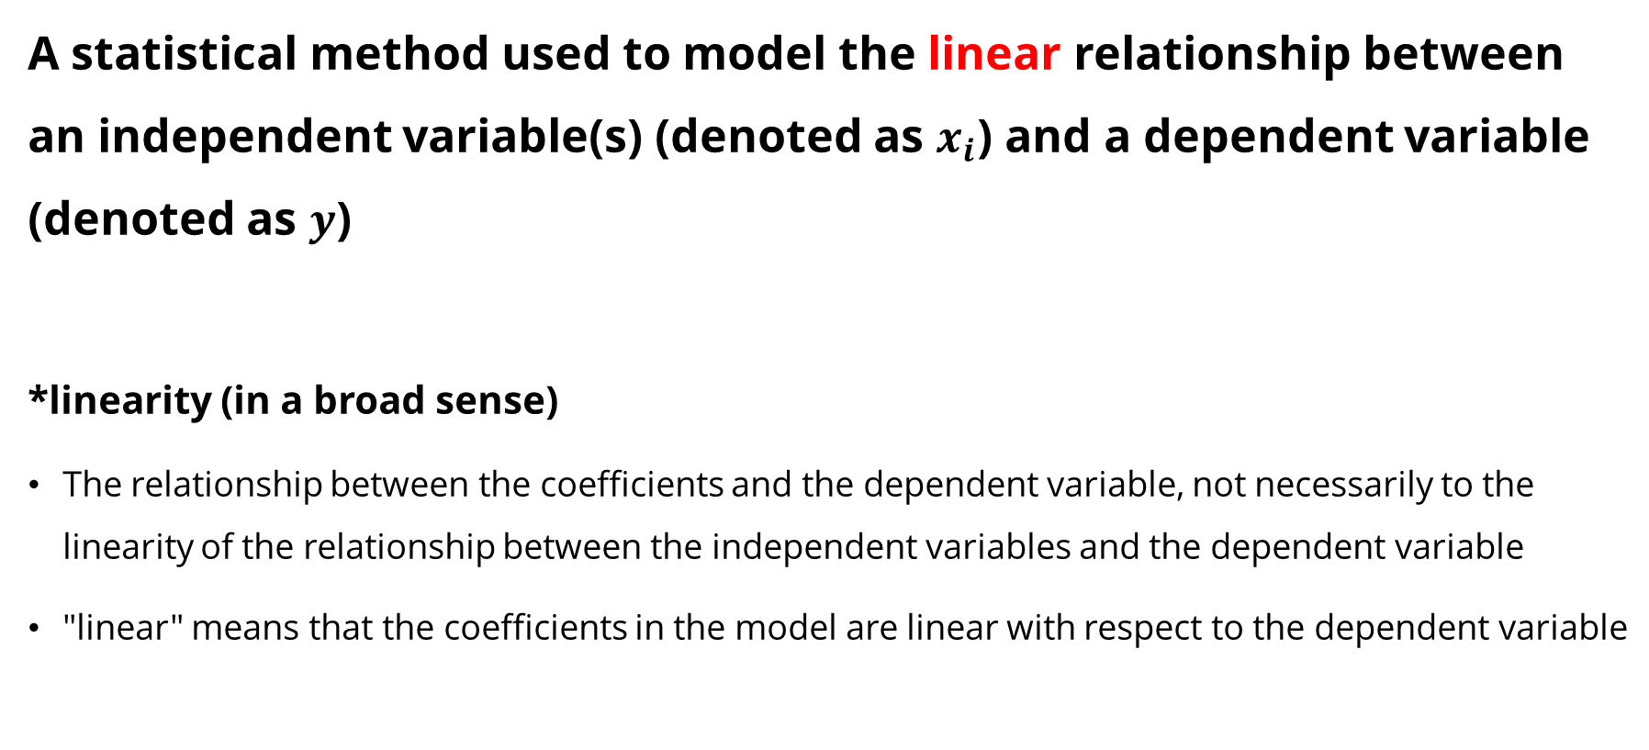
1. Linear Regression
A statistical method used to model the linear relationship between an independent variable(s) (denoted as $x_{i}$) and a dependent variable (denoted as $y$)
*linearity (in a broad sense)
The relationship between the coefficients and the dependent variable, not necessarily to the linearity of the relationship between the independent variables and the dependent variable
"linear" means that the coefficients in the model are linear with respect to the dependent variable

Slide 9

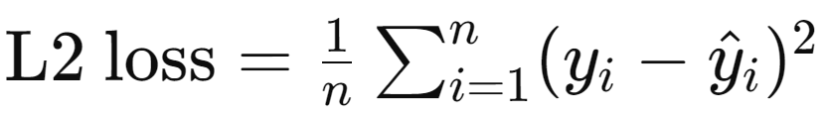
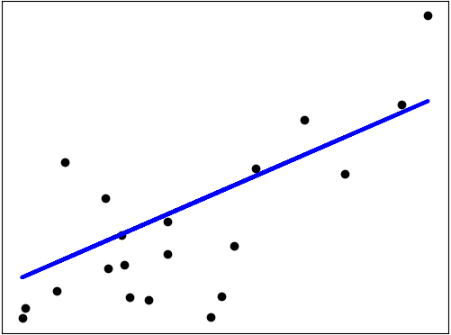
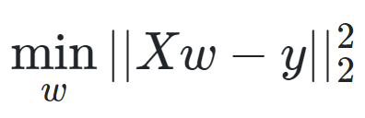
1. Linear Regression
Ordinary Least Squares (OLS)
OLS loss function aims to find the line that best fits the observed value by minimizing the residual sum of squares (RSS) between the observed and predicted values.
Mathematically, it solves a problem of the form:
제곱
예측값
N2 norm
https://scikit-learn.org/stable/modules/linear_model.html#ordinary-least-squares

Slide 10
Regression Evaluation Metrics
The metrics used to evaluate the performance of regression models
MAE (Mean Absolute Error)
MSE (Mean Squared Error)
RMSE (Root Mean Squared Error)
R² (R-squared)

Slide 11
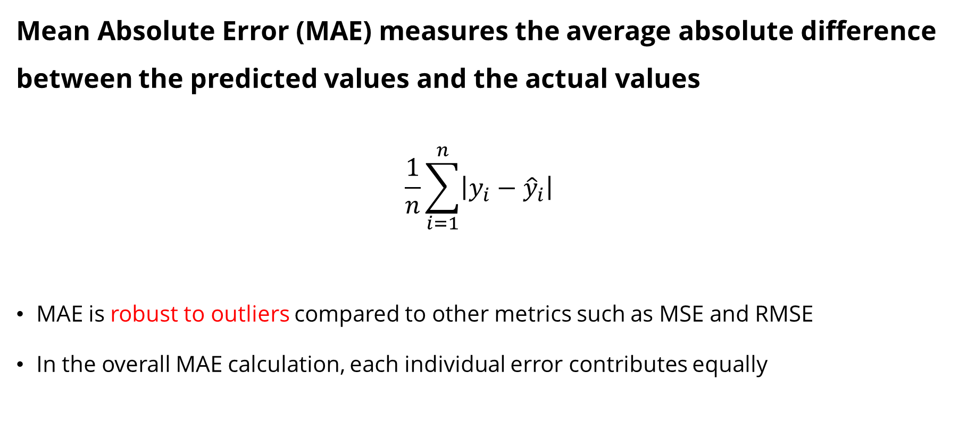
1) MAE
Mean Absolute Error (MAE) measures the average absolute difference between the predicted values and the actual values
$$\frac{1}{n}\sum_{i=1}^{n}{\left|y_{i}−{\hat{y}}_{i}\right|}$$
MAE is robust to outliers compared to other metrics such as MSE and RMSE
In the overall MAE calculation, each individual error contributes equally
아웃라이어에 강함

Slide 12
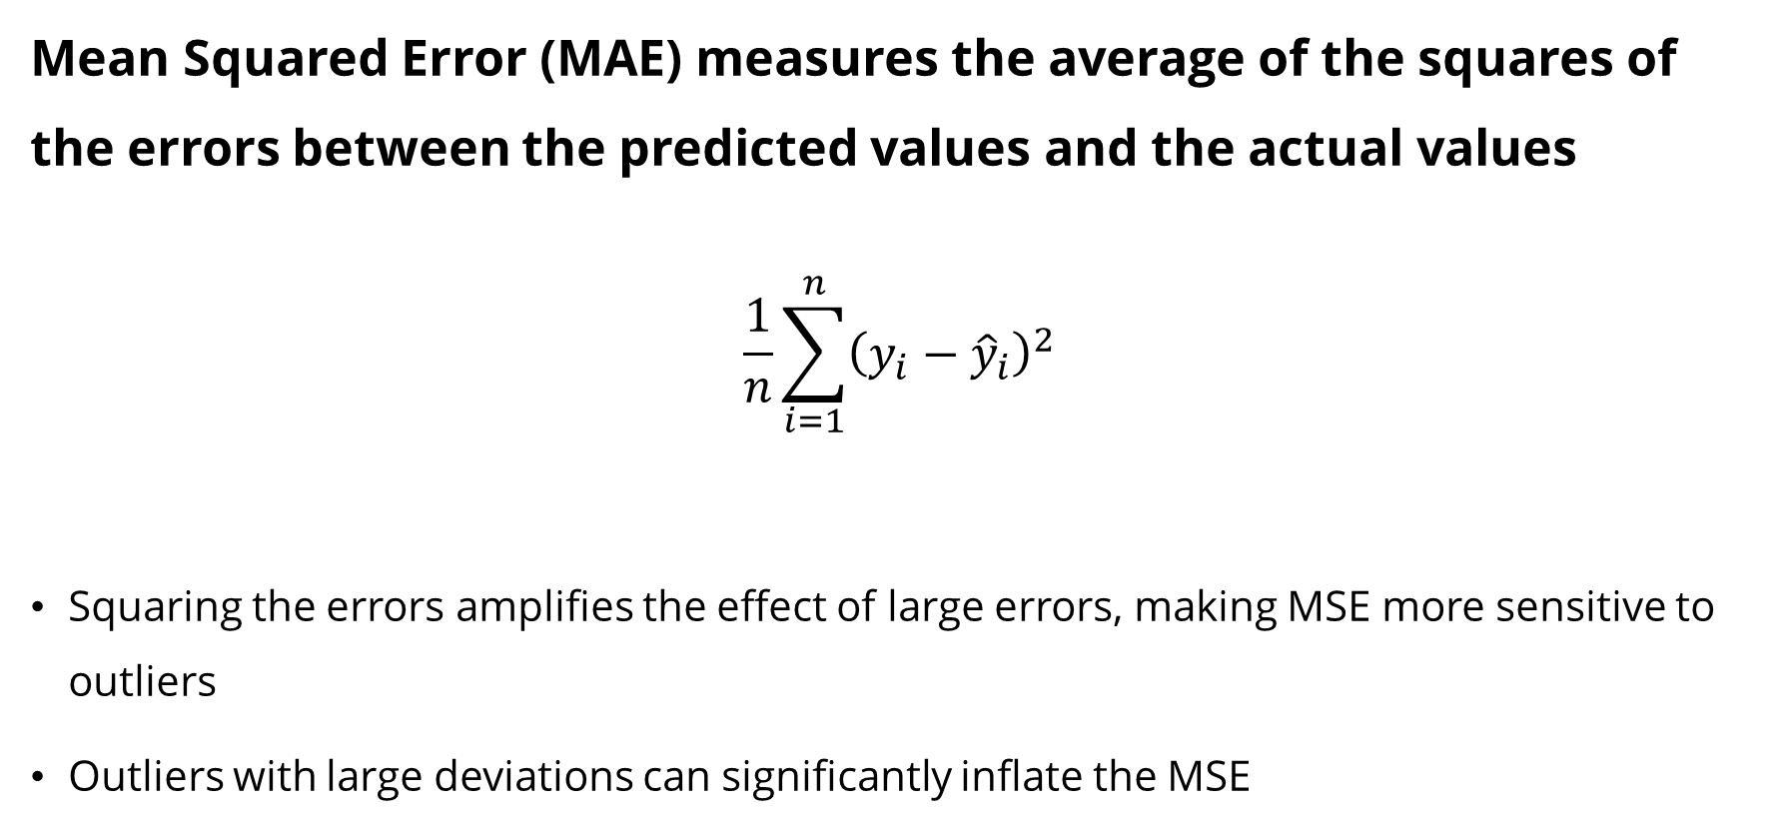
2) MSE
Mean Squared Error (MAE) measures the average of the squares of the errors between the predicted values and the actual values
$$\frac{1}{n}\sum_{i=1}^{n}{{\left(y_{i}−{\hat{y}}_{i}\right)}^{2}}$$
Squaring the errors amplifies the effect of large errors, making MSE more sensitive to outliers
Outliers with large deviations can significantly inflate the MSE
분류에서 많이 벗어난 경우 매우 낮은 값이 나옴 -> 이상치에 민감함
대신 멀리떨어진 애도 잘 맞추도록 학습할 수 있음 (mae는 다 동일하게 학습시킴)

Slide 13
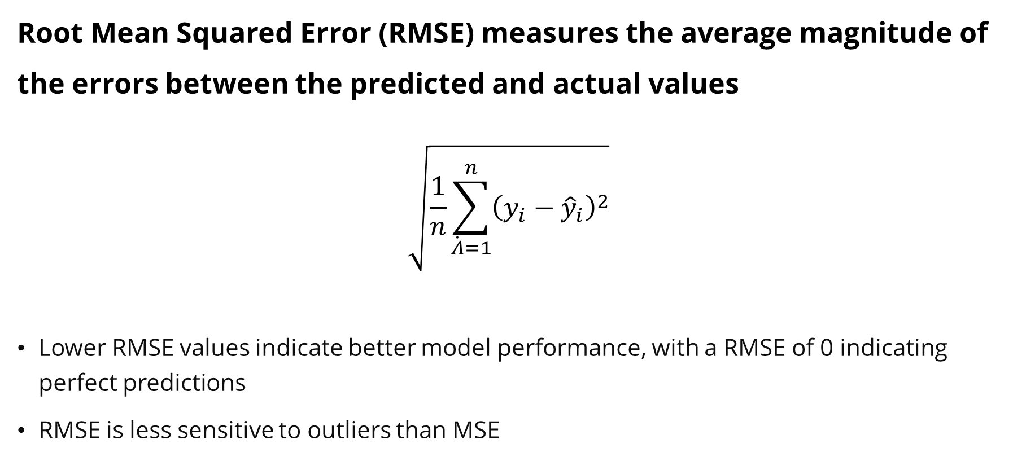
3) RMSE
Root Mean Squared Error (RMSE) measures the average magnitude of the errors between the predicted and actual values
$$\sqrt{\frac{1}{n}\sum_{\dot{Λ}=1}^{n}{{\left(y_{i}−{\hat{y}}_{i}\right)}^{2}}}$$
Lower RMSE values indicate better model performance, with a RMSE of 0 indicating perfect predictions
RMSE is less sensitive to outliers than MSE
이상치가 있었어도 값이 작게 나옴

Slide 14
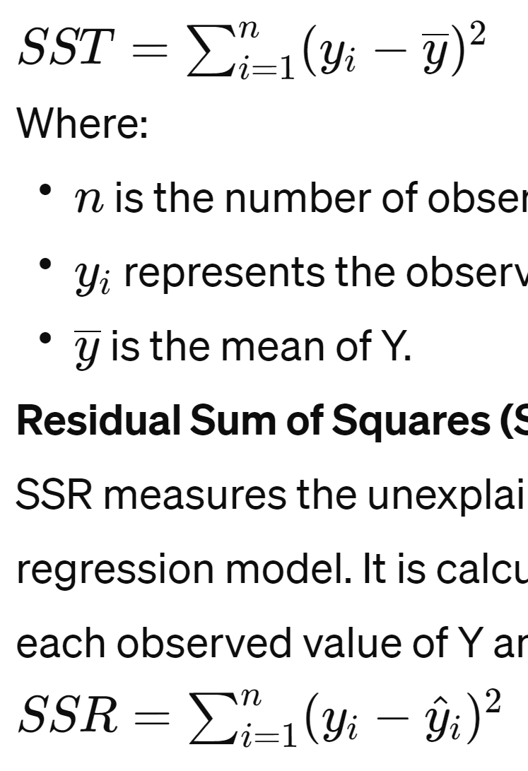
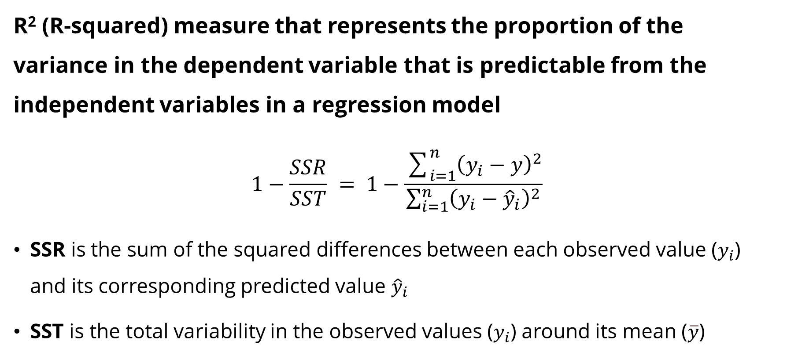
4) R²
R² (R-squared) measure that represents the proportion of the variance in the dependent variable that is predictable from the independent variables in a regression model
$$1−\frac{SSR}{SST} = 1−\frac{\sum_{i=1}^{n}{{\left(y_{i}−y\right)}^{2}}}{\sum_{i=1}^{n}{{\left(y_{i}−{\hat{y}}_{i}\right)}^{2}}}$$
SSR is the sum of the squared differences between each observed value ($y_{i}$) and its corresponding predicted value ${\hat{y}}_{i}$
SST is the total variability in the observed values ($y_{i}$) around its mean ($\overline{y}$)
실제값-예측값
실제값-실제 평균값
다른 모델끼리도 비교 가능 (0~1사이로 정규화되기 때문)

Slide 15
4) R²
R² (R-squared) measure that represents the proportion of the variance in the dependent variable that is predictable from the independent variables in a regression model
0 indicates that the model does not explain any of the variability in the dependent variable (bad)
1 indicates that the model explains all of the variability in the dependent variable (good)
Interpretability: R² directly indicates how well the model explains the variability of the dependent variable
Sample Size Correction: R² is less sensitive to changes in sample size compared to others (i.e., MAE, MSE, and RMSE)

Slide 16
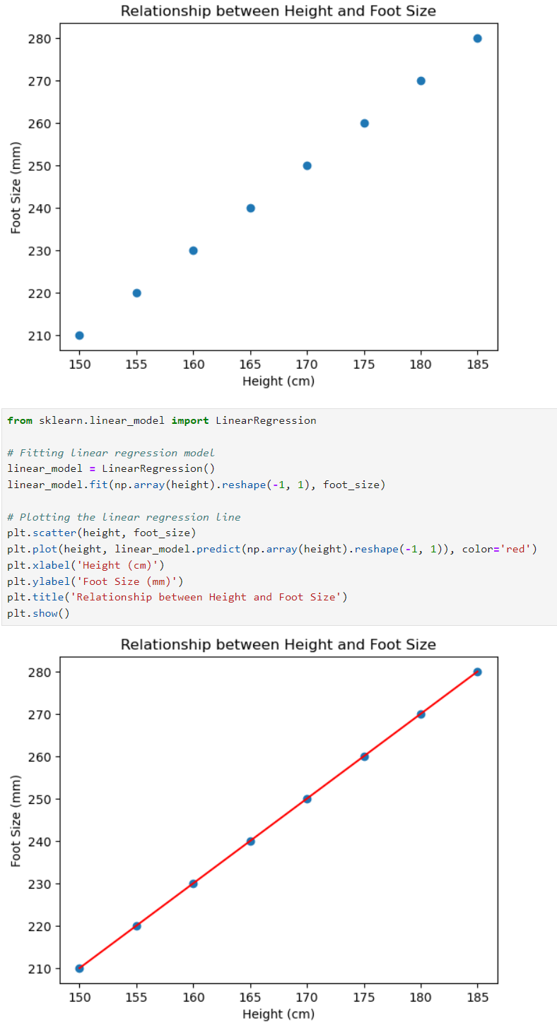
1. Linear Regression

Slide 17

1. Linear Regression
MAE: 0
MSE: 0
RMSE: 0
R²: 1.0
$$y=2x_{1}−90$$

Slide 18
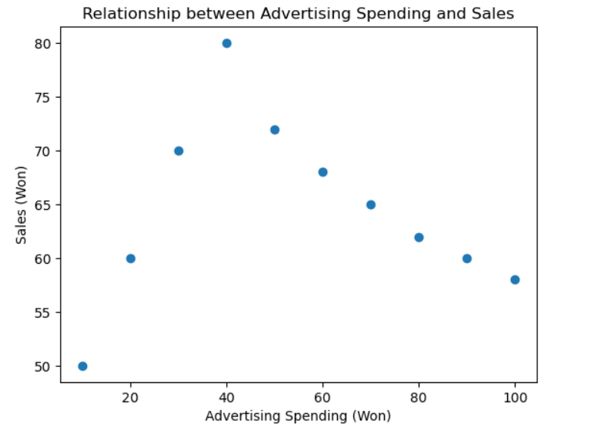
1. Linear Regression

Slide 19
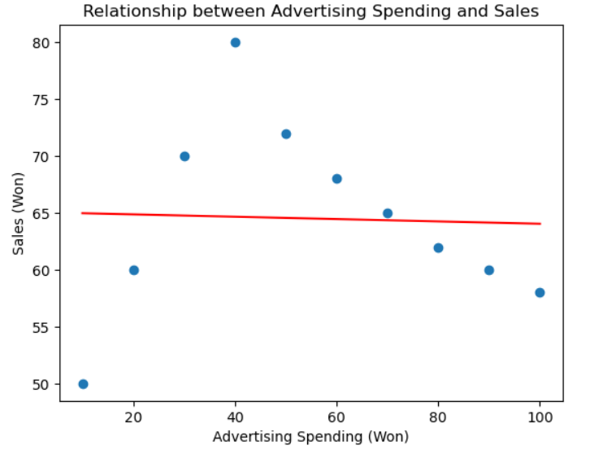
1. Linear Regression
MAE: 6.4485
MSE: 63.7624
RMSE: 7.9851
R²: 0.0014

Slide 20
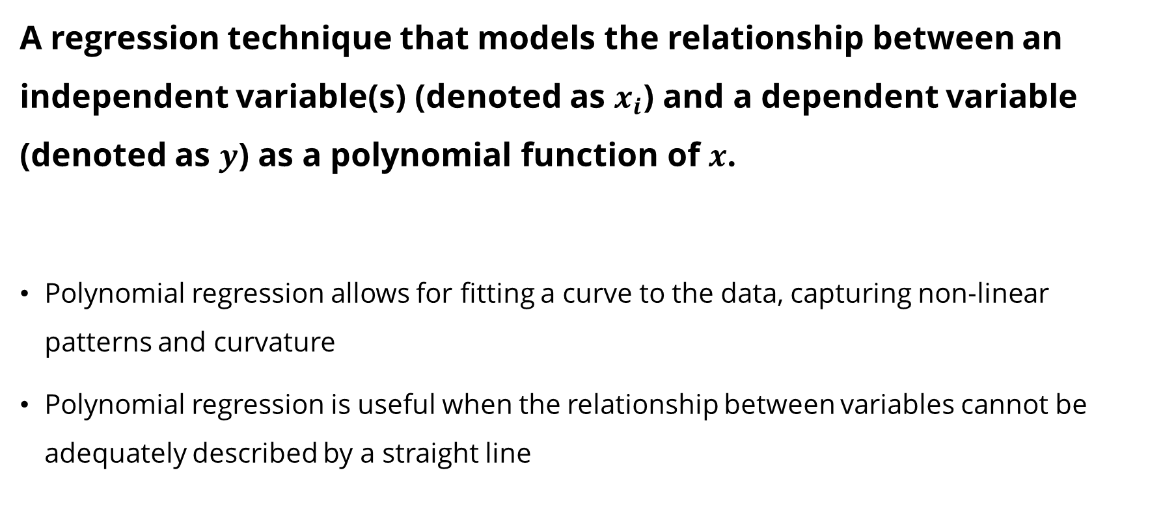
2. Polynomial Regression
A regression technique that models the relationship between an independent variable(s) (denoted as $x_{i}$) and a dependent variable (denoted as $y$) as a polynomial function of $x$.
Polynomial regression allows for fitting a curve to the data, capturing non-linear patterns and curvature
Polynomial regression is useful when the relationship between variables cannot be adequately described by a straight line

Slide 21
2. Polynomial Regression

Slide 22
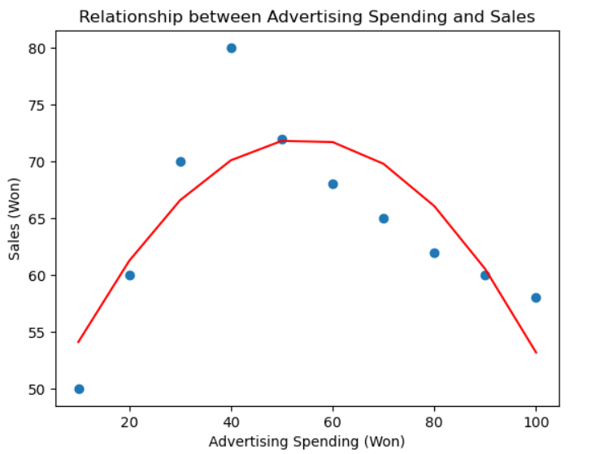

2. Polynomial Regression
$$degree=2$$
MAE: 3.6758
MSE: 20.4889
RMSE: 4.5265
R²: 0.6791
$$y=−0.009x_{1}2+{0.986x}_{1}+45.15$$

Slide 23
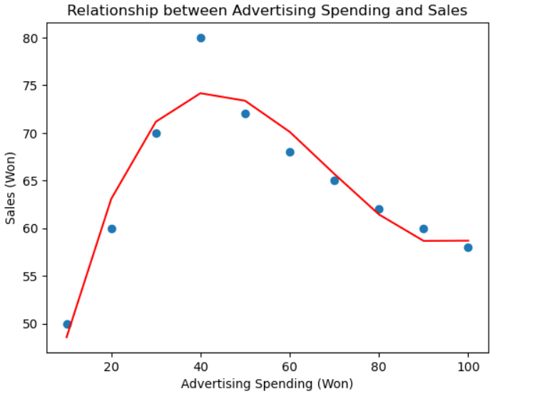

3. Polynomial Regression
$$degree=3$$
MAE: 1.8275
MSE: 5.633
RMSE: 2.3734
R²: 0.9118
$$y=0.0002x_{1}3−0.0452x_{1}2+2.6544x_{1}+0$$

Slide 24
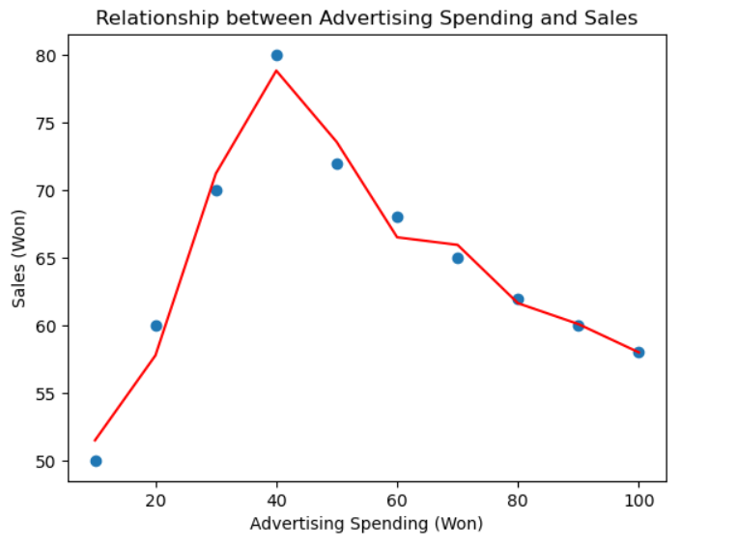

4. Polynomial Regression
$$degree=10$$
MAE: 1.0556
MSE: 1.573
RMSE: 1.2542
R²: 0.9754

Slide 25
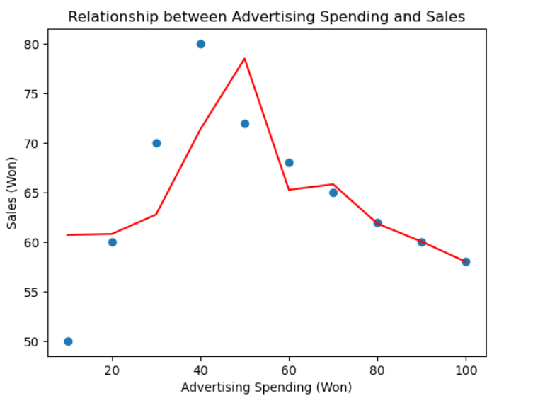

4. Polynomial Regression
$$degree=15$$
MAE: 3.763
MSE: 29.2886
RMSE: 5.4119
R²: 0.5413

Slide 26
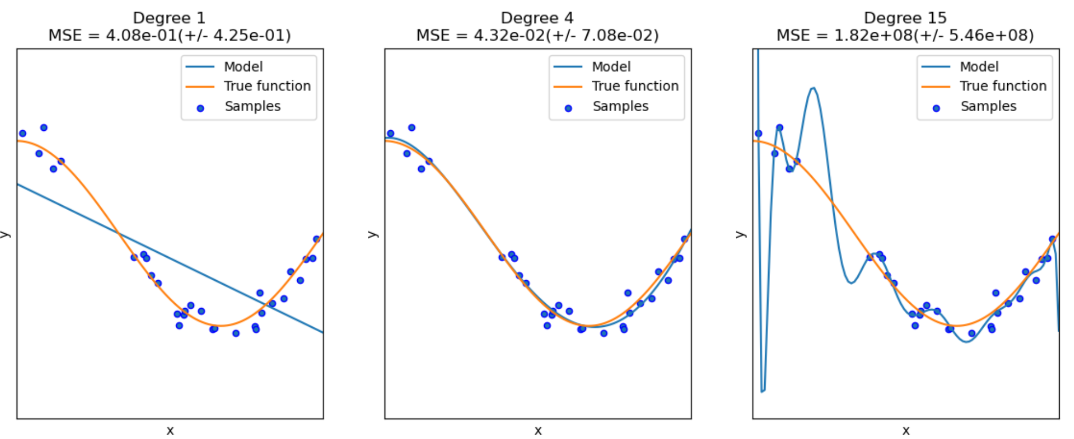
2. Polynomial Regression
https://scikit-learn.org/stable/auto_examples/model_selection/plot_underfitting_overfitting.html

Slide 27
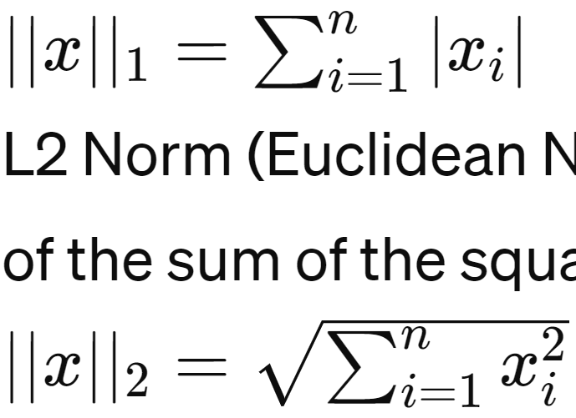
Norm
Norm
A norm is a function that assigns a strictly positive length, size, or distance to each vector in a vector space (except for the zero vector)
L1 Norm (Manhattan Norm)
This norm is defined as the sum of the absolute values of the vector components.
L2 Norm (Euclidean Norm)
This norm is defined as the square root of the sum of the squares of the vector components.
바둑판 거리
직선 거리

Slide 28
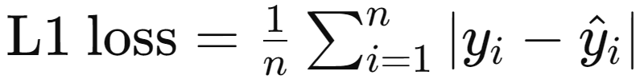
1) L1 Norm
L1 Norm
This norm is defined as the sum of the absolute values of the vector components
L1 Loss is robust to outliers compared to L2 Loss
https://www.gabormelli.com/RKB/L1_Norm_Distance_Function

Slide 29
2) L2 Norm
L2 Norm
This norm is defined as the sum of the absolute values of the vector components
L2 Loss is sensitive to outliers compared to L1 Loss
https://www.gabormelli.com/RKB/L2_Norm_Distance_Function

Slide 30

Ridge Regression
A linear regression technique that is used to prevent overfitting in OLS linear regression modeling
The objective of Ridge regression is to find the coefficient vector (w) that minimizes
λ (alpha) is the regularization parameter or penalty term, which controls the strength of the regularization. Higher values of λ result in more regularization
By penalizing the magnitude of the coefficients, Ridge regression helps to stabilize the model and improve its generalization performance on unseen data
OLS Loss (RSS)
λ × L2 Loss
알파는 파라미터 튜닝으로 알아서 조절해야함

Slide 31
Lasso Regression
A linear regression technique that, similar to Ridge regression, is used to prevent overfitting in OLS linear regression modeling
The objective of Lasso regression is to find the coefficient vector (w) that minimizes
This penalty term encourages sparsity in the coefficient vector by penalizing coefficients with large magnitudes, effectively driving some coefficients to exactly zero (feature selection)
LASSO stands for "Least Absolute Shrinkage and Selection Operator."
OLS Loss (RSS)
λ × L1 Loss
계수가 0이 될 수도 있다 -> feature selection

Slide 32
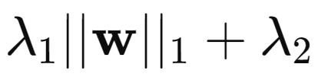
ElasticNet Regression
A linear regression technique that combines the properties of Ridge regression and Lasso regression
The objective of Ridge regression is to find the coefficient vector (w) that minimizes
By incorporating both types of penalties, ElasticNet regression is able to handle multicollinearity, perform variable selection, and control model complexity more effectively compared to using Ridge or Lasso regression alone
OLS Loss (RSS)
λ × L1 Loss
λ × L2 Loss
단점 : 데이터가 많아야함

Slide 33
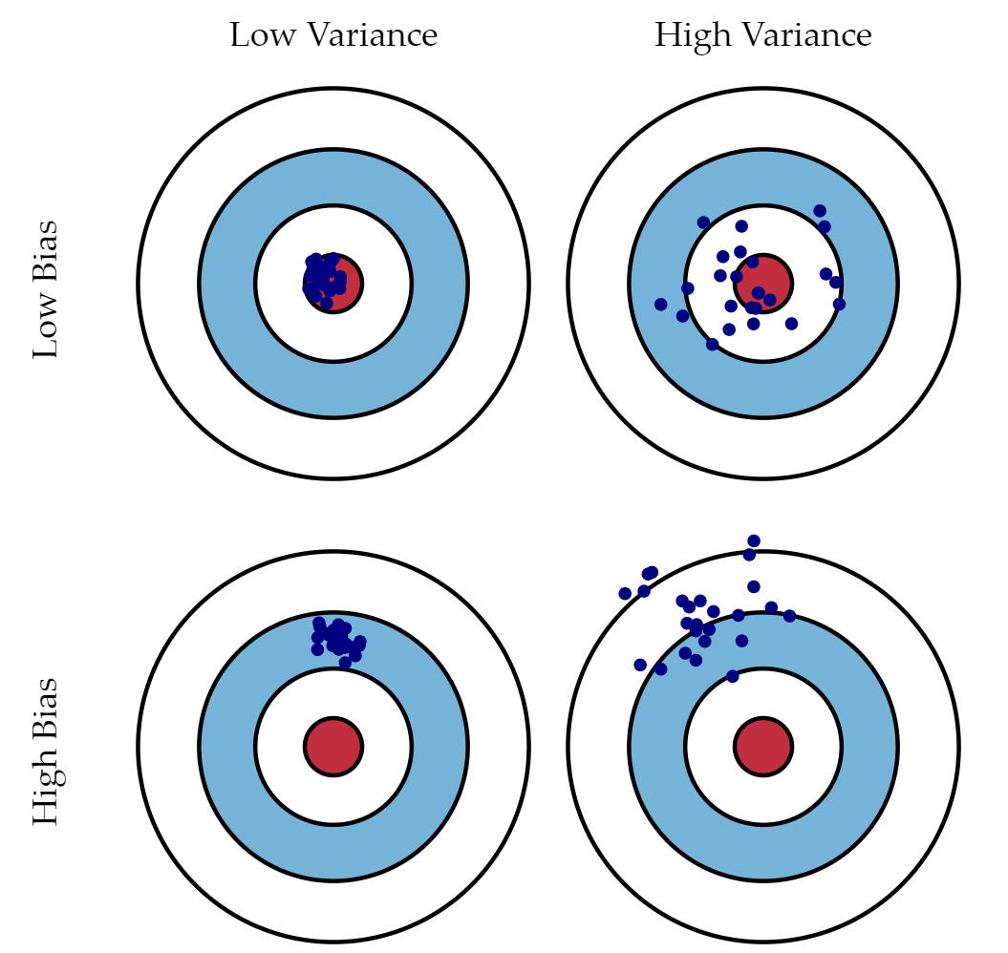
Bias-Variance Trade-off
Scott Fortmann-Roe, "Understanding the Bias-Variance Tradeoff", 2012
Notes:
in Ridge regression, the larger the ridge alpha parameter, the higher the bias and the lower the variance.

Slide 34
Assumptions of Linear Regressions
Linearity | 선형성
The relationship between the independent variables and the dependent variable should be linear
This means that changes in the independent variables are associated with a constant change in the dependent variable when all other variables are held constant
Independence | 독립성
There is no correlation between errors (residuals)
The errors (residuals) should be independent of each other
Homoscedasticity | 등분산성
The variance of the errors (residuals) should be constant across all levels of the independent variables
Normality | 정규성
The errors (residuals) should be normally distributed

Slide 35
Limitations of Linear Regressions
Simplistic in some cases
The linear regression model is great for data that has a linear relationship between the dependent and independent variables
Sensitivity to outliers
the linear regression model uses the OLS model to estimate the coefficients. So, any observation that is away from the major cluster of points will have a squared impact, leading to biased results.
Prone to underfitting
Underfitting occurs when a model cannot adequately capture the underlying structure of the data
Overfitting of complex models
Contrary to underfitting, overfitting happens when the model fits the data too well, sometimes capturing the noise too. this usually happens when the model is too complex with many parameters, and the data is too less.

Slide 36
Appendix | Data Scientist Interview Questions
Airbnb
Say you are running a simple logistic regression to solve a problem but find the results to be unsatisfactory. What are some ways you might improve your model, or what other models might you look into using instead? (from Huo and Singh, Ace the data science interview, 2022)
Google
Can you discuss your experience with LASSO RIDGE research papers and optimization?
"The actual questions were pretty tough. Most were more statistical than programming-based. They were interested in my understanding of parameter estimation for click through rate problems and also my knowledge of linear models with and without regularization (i.e., Lasso and Ridge regression)" Senior Data Scientist Interview at Google, 2019

